Slide 1

VA.gov Patient Portal Sprint Readout
January 10, 2020

Slide 2
Purpose of sprint
SCOPE
Test assumptions about existing applications
Understand the various technical and organizational environments in which these interactions (and the data integrations upon which they depend) will be built and maintained
Draft high-level recommendations on the technical approach for delivering these interactions on VA.gov
Review key design differences between the applications on Cerner, MHV/Mobile app store, retired Vets.gov versions, and design system implications
Draft recommendations for the contracting and teaming approach for integrating with Cerner and delivering these interactions on VA.gov.

Slide 3
Patient tools
SCOPE
patient questionnaires
online scheduling
prescription management
secure messaging
health record access (“Blue Button”, CCDA)
3

Slide 4
What we did
Sprint Details
Interviewed 15 SMEs across various programs, including MHV, MAP, and Lighthouse
Reviewed current and historical (e.g. vets.gov era) technical documentation
Built design comps for all products based on MHV, Cerner, and historical vets.gov functionality and features
Engaged with Cerner, TAC, and OEHRM to move API work forward
Gained deeper understanding of Cerner architecture through VAEC/networking support

Slide 5
What we found
Readout
Differing opinions on where VistA/Cerner data integration should happen (MHV, VAMF, VA.gov/vets-api)
Immense complexity in system architecture and business rules across all existing products
Uneven expectations for Cerner migration from “let’s wait and see if it sticks” to charging forward (e.g. MAP and EAS)
Majority of interviewees shared enthusiasm about integrating tools into VA.gov and delivering a unified experience
Commitment to modern software development principles across teams with honest self-assessments of progress in adopting those principles

Slide 6
Overall recommendations
Readout
The Cerner/VistA data integration required for each tool should be approached on a tool-by-tool basis and not as a single “patient portal”
Integration should occur across various environments and stacks as opposed to utilizing a single set of resources
Responsibility for integration efforts should be spread across the MHV, MAP, and VA.gov teams, with the teams with the most subject matter expertise empowered to lead these efforts
Shared/reusable components should be encouraged where they make sense, but each team should have the independence to pursue their own roadmaps

Slide 7
Tool overview
PATIENT QUESTIONNAIRE
New functionality, only applicable for Cerner sites
Pre-approved and composed set of questionnaires (e.g. pre-visit clipboard or mental health screener)
Questionnaire triggered by an interaction with a provider or scheduling event
Veteran receives notification and request for completion
Completed questionnaire returned to Millennium/HEI for provider review/action
7

Slide 8
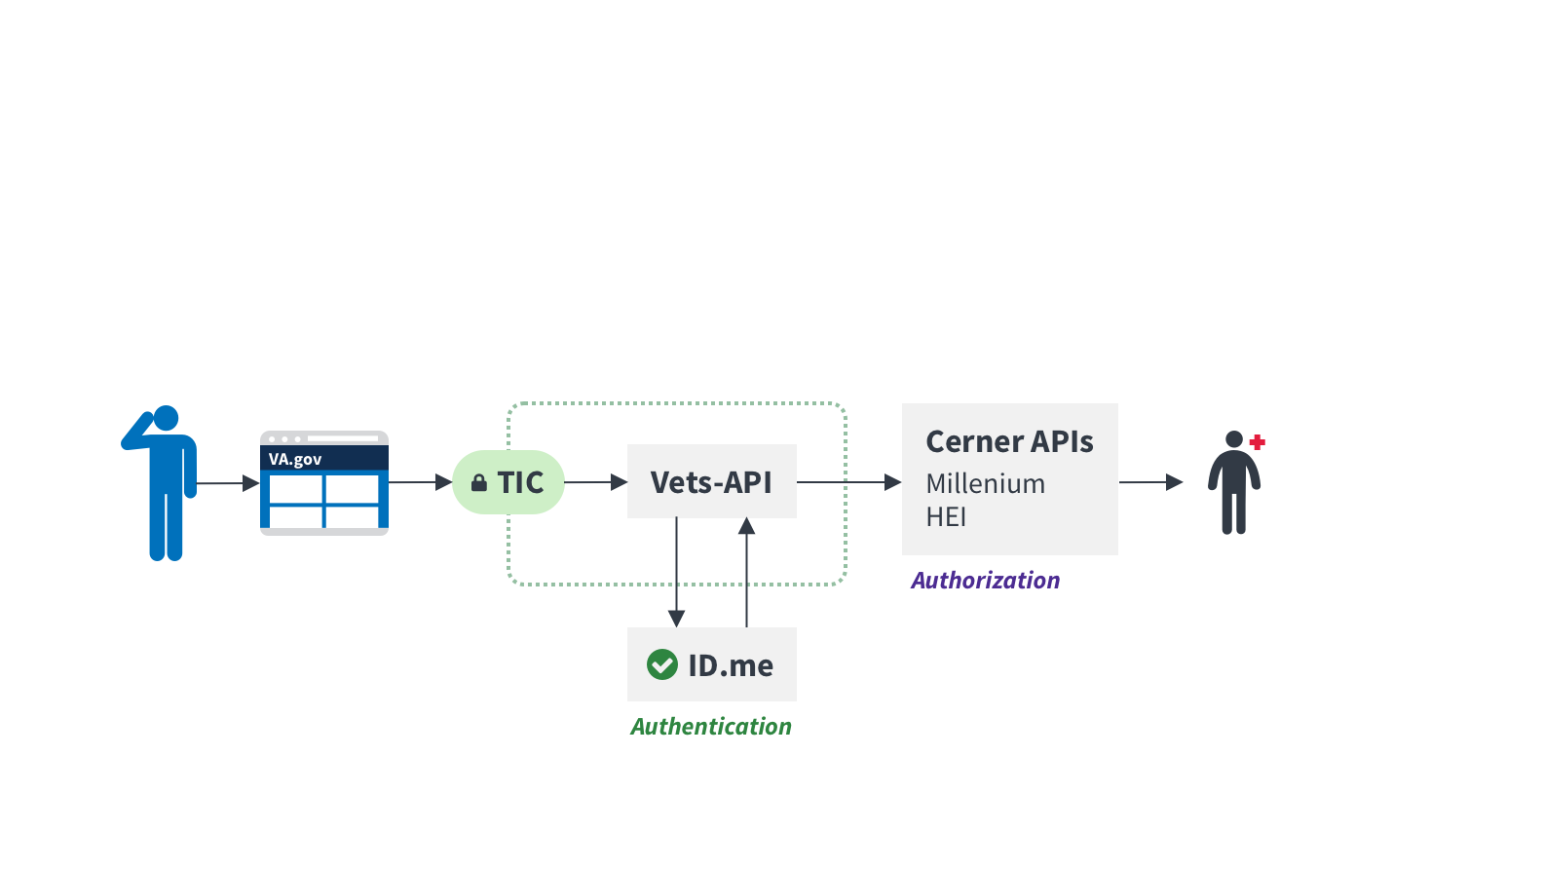
Technical approach
PATIENT QUESTIONNAIRE

Slide 9
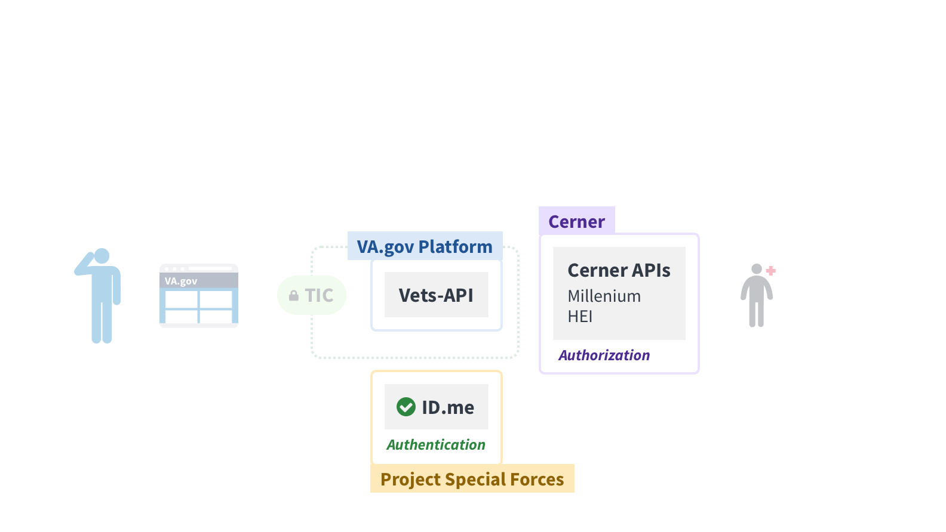
Technical approach
PATIENT QUESTIONNAIRE

Slide 10
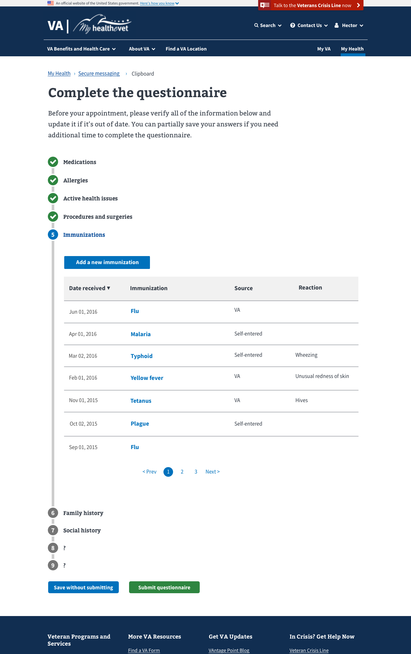
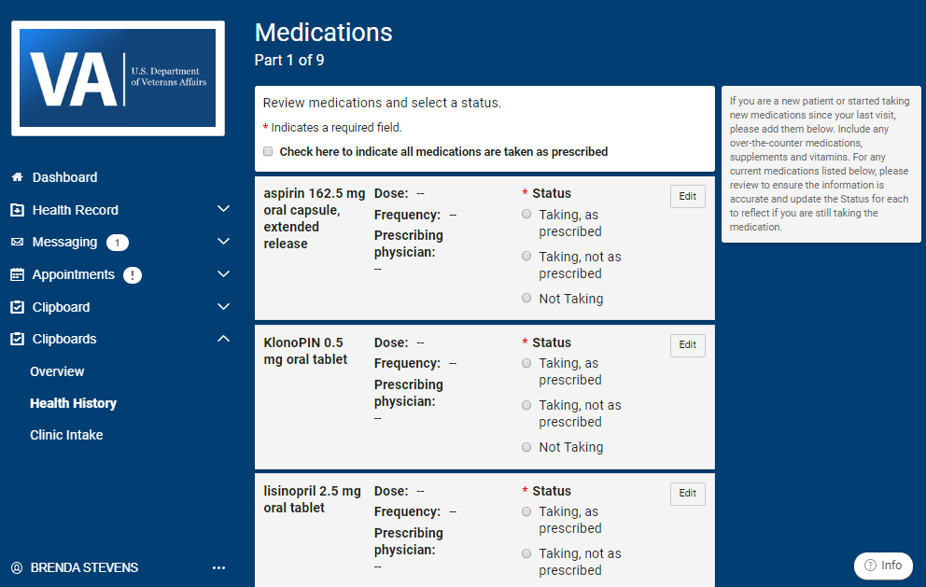
Design differences
PATIENT QUESTIONNAIRE
This is a new application that would be designed using VA design system and forms system. Notifications and alerts of new questionnaires to complete may be surfaced on a user's VA.gov profile.
10
Design comparison: https://github.com/department-of-veterans-affairs/digitalservice/blob/master/product-lines/health/va.gov-patient-experience/va-front-door-discovery-sprint/design/ComparisonClipboard.docx

Slide 11
Funding and teaming approach
PATIENT QUESTIONNAIRE
Because this is a new application to VA and will be offered for Cerner sites only with no integration with VistA or other legacy backends, secure a team on HI&M, new CEDAR IDIQ, or VSA.
Team would be made up of one larger product scrum team with back-end engineers who would be able to manage the direct integration with Cerner APIs and handle the API calls.
Depends on Cerner enabling a new questionnaire API.
11

Slide 12
Tool overview
Online Scheduling
VistA/Cerner data integration necessary to deliver unified Veteran experience
Integration effort already underway via the Enterprise Appointment System (EAS) by the MAP team; front-end effort already underway by the AdHoc/Ironbow team on VSP.
View, cancel, direct scheduling, and VA and community care appointment requests for providers with a pre-existing relationship

Slide 13
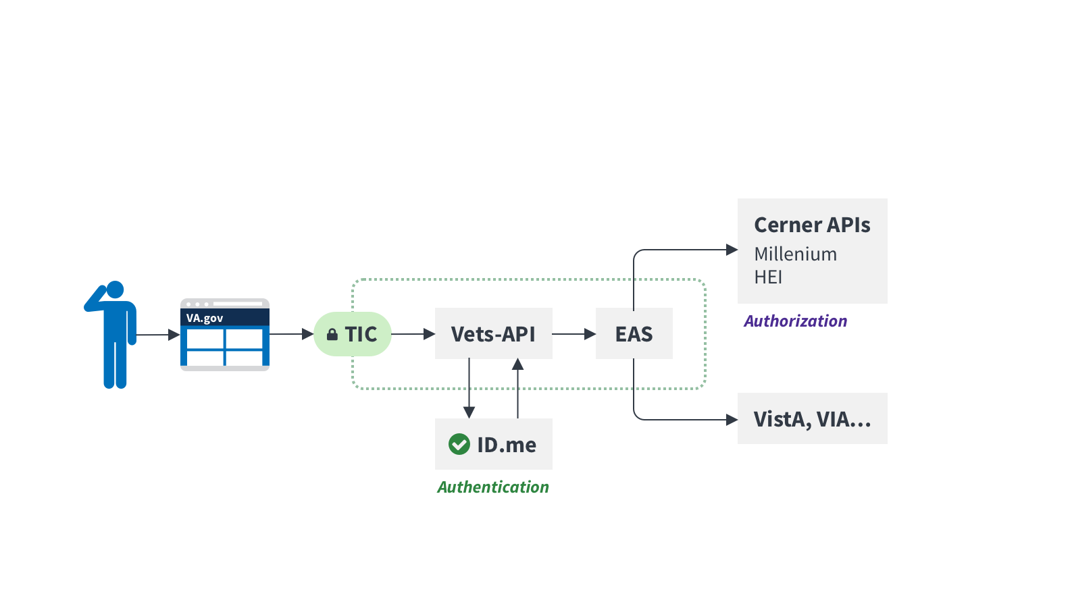
Technical approach
ONLINE SCHEDULING
13
Notes:
Should we gather confidence that EAS is reliable, standardized, and has appropriate documentation and monitoring in place, we could consider cutting vets-api out of part of this interaction to enable a more direct connection to EAS and cut out the creation of wrappers for each service.

Slide 14
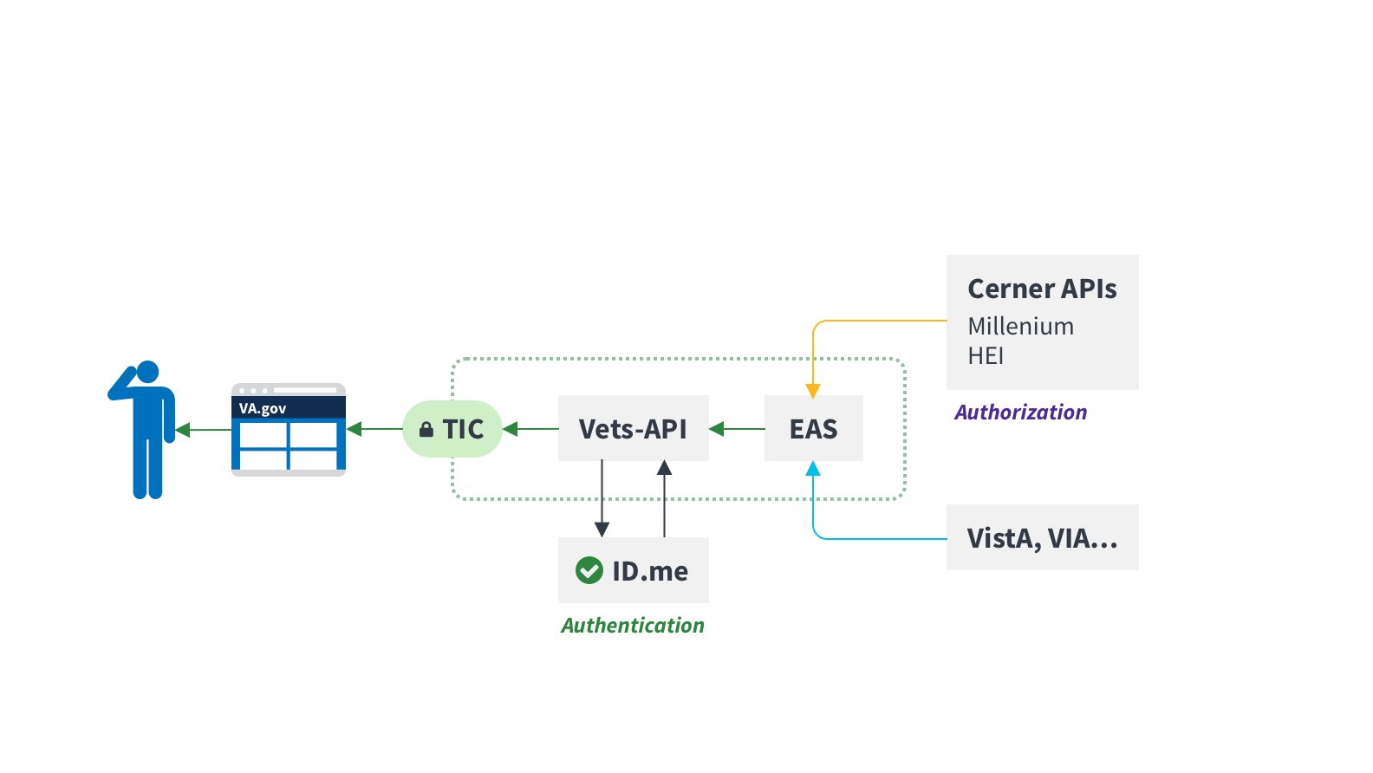
Technical approach
ONLINE SCHEDULING
14
Notes:
Should we gather confidence that EAS is reliable, standardized, and has appropriate documentation and monitoring in place, we could consider cutting vets-api out of part of this interaction to enable a more direct connection to EAS and cut out the creation of wrappers for each service.

Slide 15
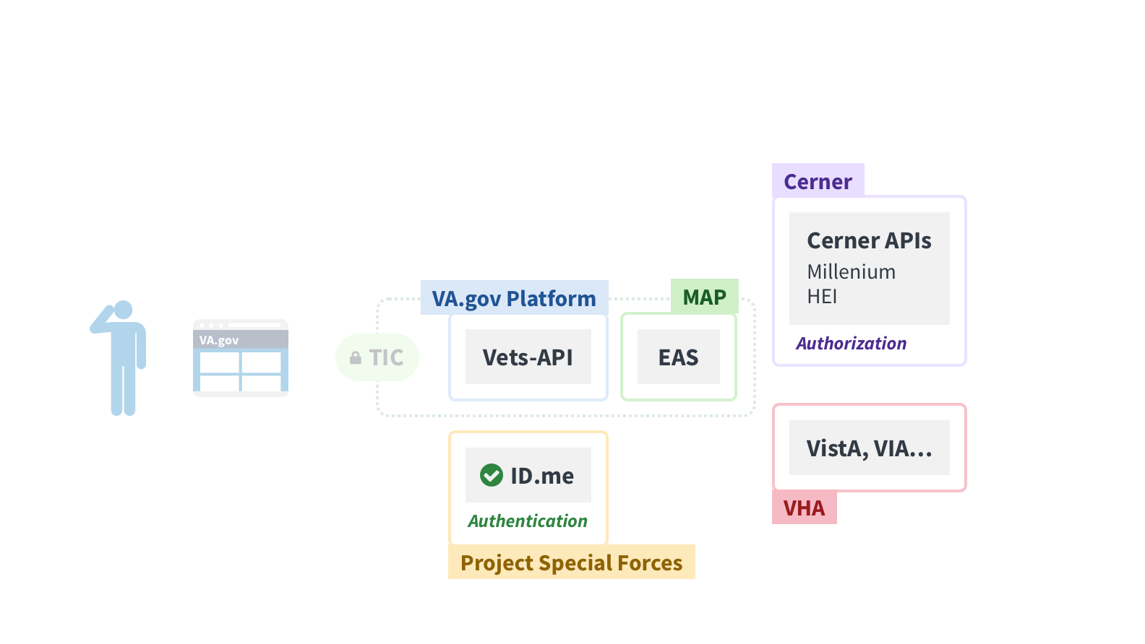
Technical approach
ONLINE SCHEDULING
15
Notes:
Should we gather confidence that EAS is reliable, standardized, and has appropriate documentation and monitoring in place, we could consider cutting vets-api out of part of this interaction to enable a more direct connection to EAS and cut out the creation of wrappers for each service.

Slide 16
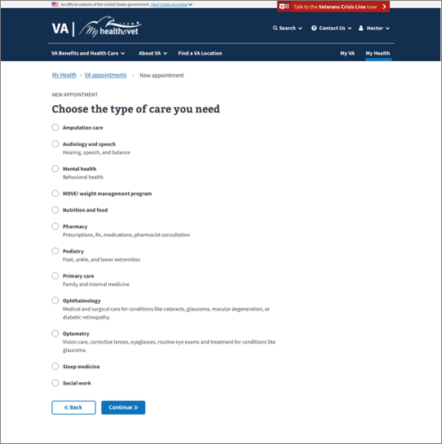
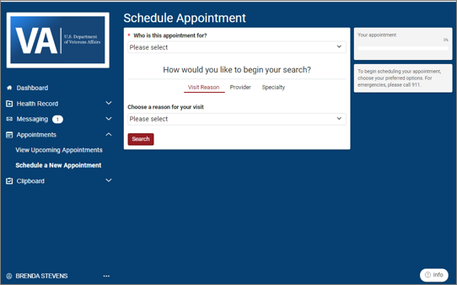
Design differences
ONLINE SCHEDULING
https://github.com/department-of-veterans-affairs/digitalservice/blob/master/product-lines/health/va.gov-patient-experience/va-front-door-discovery-sprint/design/ComparisonScheduling.docx
16
Notes:
- Cerner

Slide 17
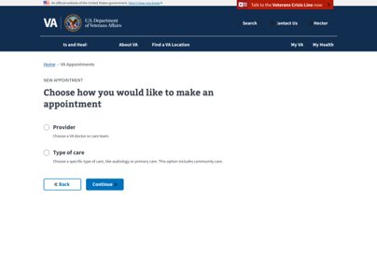
Design differences continued
ONLINE SCHEDULING
Provider-based scheduling
A patient at a Cerner site can start their appointment journey by selecting a provider or a reason for an appointment.
FE experience team has completed initial research for a provider flow. At this time, this cannot be supported in VistA.
Early in transition, this could be integrated into existing flow replacing the clinic selection page. Once more facilities are transitioned to Cerner, it could be a standalone flow.
A reason-for-appointment flow would require additional technical research, and may be something we could add in as additional sites transition to Cerner.
17
Notes:
- Cerner

Slide 18
Funding and teaming approach
ONLINE SCHEDULING
Continue to use the existing mobile contracts to support Apothesource to develop and maintain EAS to handle the integrations with Cerner.
For the front-end on VA.gov, once the Ad Hoc team current contract under Ironbow runs out in June, move existing team either to HI&M or VSA under CTO. Continue to develop front-end experience in adherence with Cerner and using existing APIs post MVP final release and IOC.
18

Slide 19
Tool overview
Prescription Management
Refills and renewals
VistA/Cerner data integration necessary to deliver unified Veteran experience
Build new integration point within the MHV environment but isolated from the existing MHV application and stack
Integration point proxies calls to Cerner and necessary VistA and other legacy backends

Slide 20
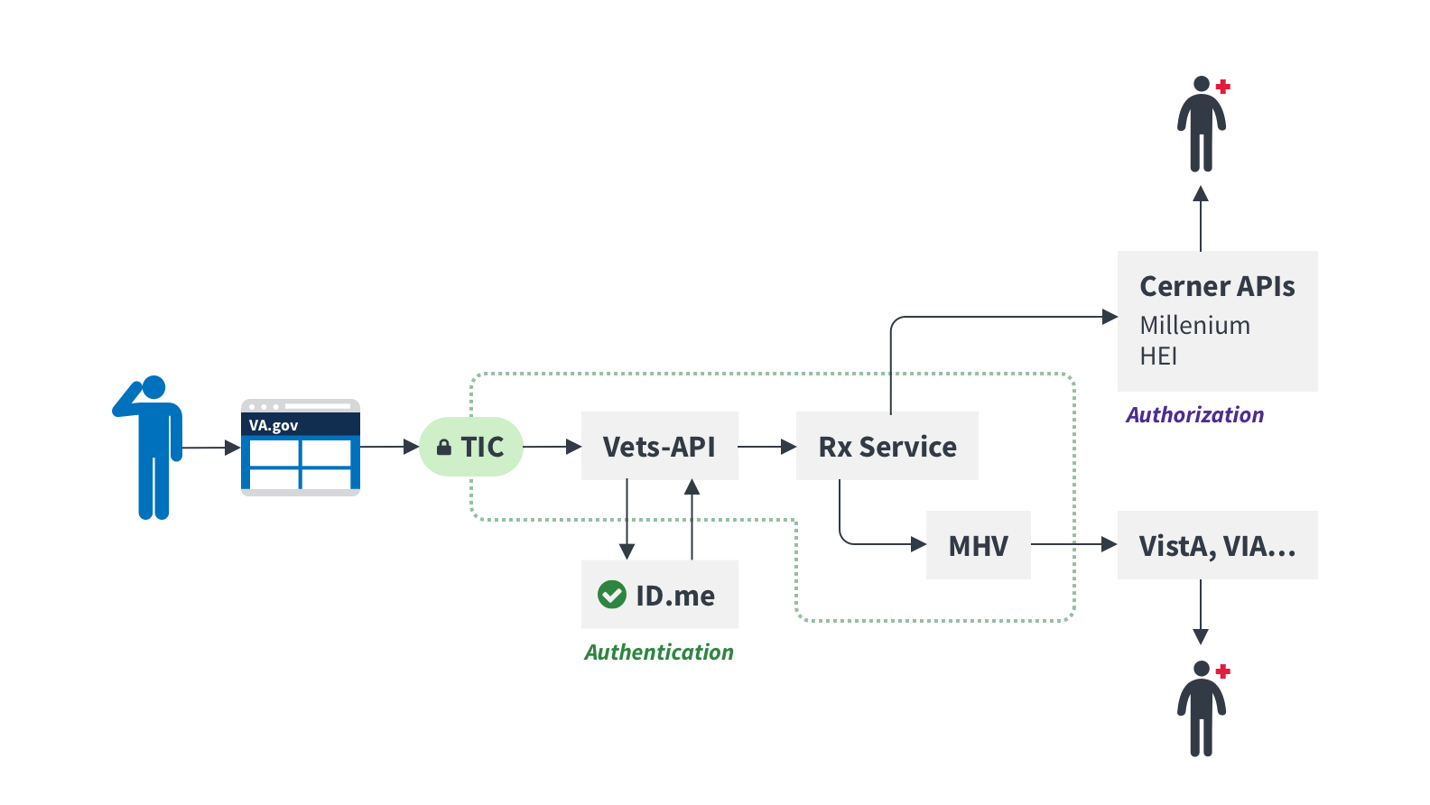
Technical approach
Prescription Management
20
Notes:
Should we gather confidence that EAS is reliable, standardized, and has appropriate documentation and monitoring in place, we could consider cutting vets-api out of part of this interaction to enable a more direct connection to EAS and cut out the creation of wrappers for each service.

Slide 21
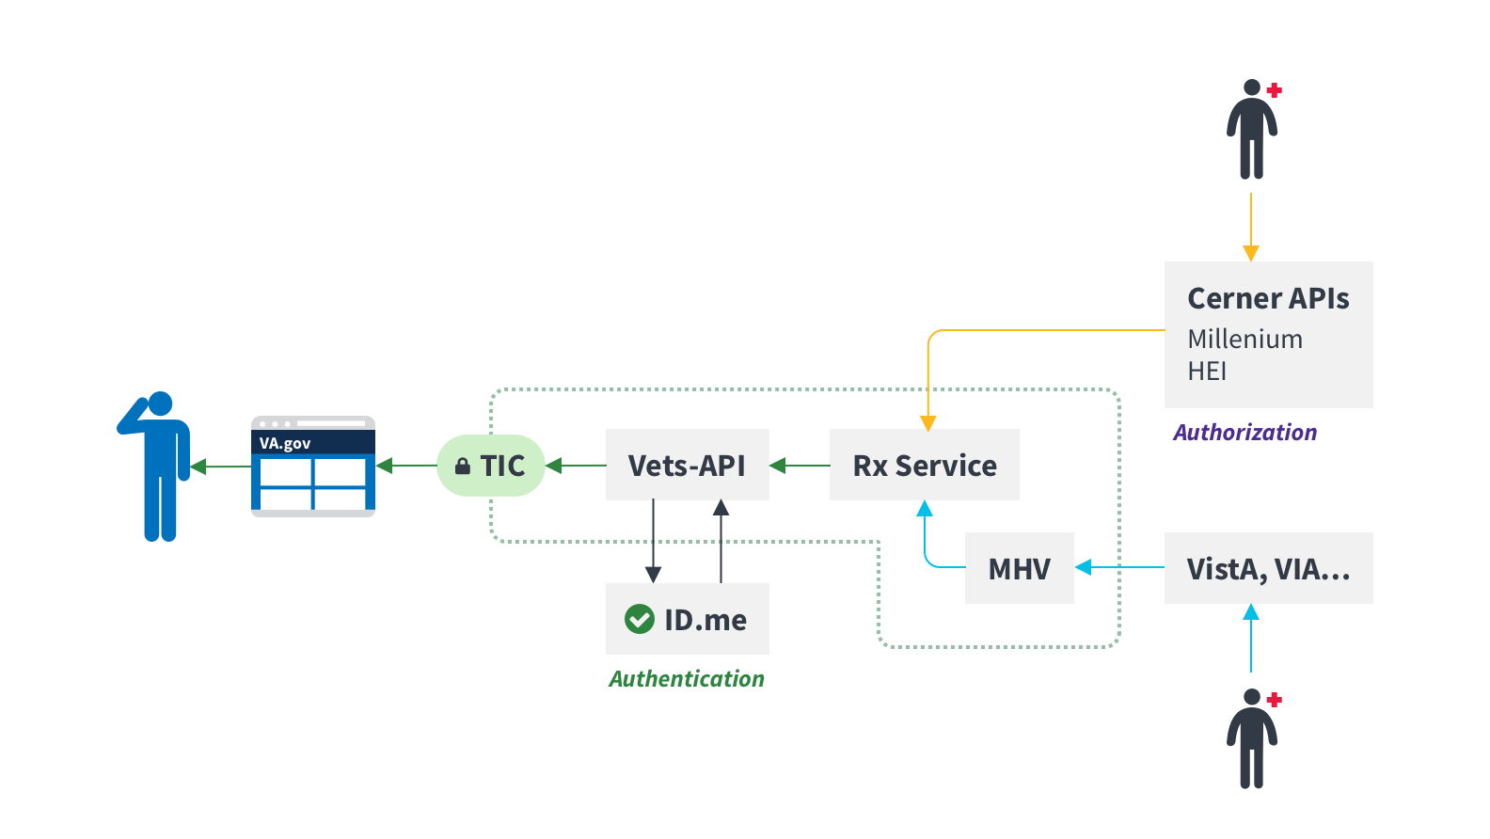
Technical approach
Prescription Management
21
Notes:
Should we gather confidence that EAS is reliable, standardized, and has appropriate documentation and monitoring in place, we could consider cutting vets-api out of part of this interaction to enable a more direct connection to EAS and cut out the creation of wrappers for each service.

Slide 22
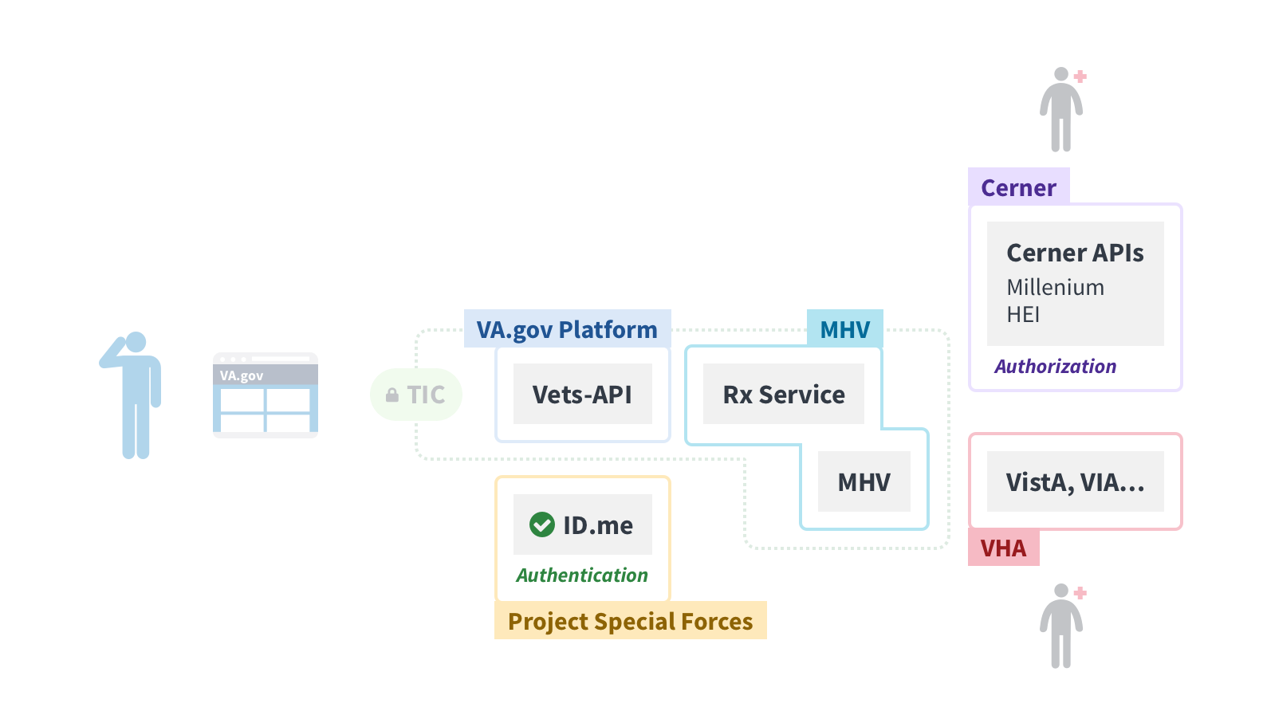
Technical approach
Prescription Management
22
Notes:
Should we gather confidence that EAS is reliable, standardized, and has appropriate documentation and monitoring in place, we could consider cutting vets-api out of part of this interaction to enable a more direct connection to EAS and cut out the creation of wrappers for each service.

Slide 23
Design differences
PRESCRIPTION MANAGEMENT
Feature | Current MHV | Current Cerner | Vets.gov original mockups | VA.gov new mockups
Refill VA prescriptions through the app | X |  | X | X
Send a renew request |  | X
VA prescription history | X |  | X | X
VA prescription tracking | X |  | X | X
My medications list | X | X |  | X
VA medications list | X |  | X | X
Self-entered meds and supplements | X |  |  | X
Allergies and adverse reactions | X | X |  | X
Source of prescription (i.e., VA, community care, self-entered) | X |  |  | X
Glossary | X |  | X | X
Prescription start/end dates | X (“ordered on” date?) | X |  | X
Design comparison: https://github.com/department-of-veterans-affairs/digitalservice/blob/master/product-lines/health/va.gov-patient-experience/va-front-door-discovery-sprint/design/ComparisonMedications.docx
23
Notes:
- Cerner

Slide 24
PRESCRIPTION MANAGEMENT
Feature | Current MHV | Current Cerner | Vets.gov original | New VA.gov
VA copayment (home page displays link to generic page of info)​ | X​ | ​ | ​ | ​Can be added
VA copayment (display actual amount on med details page)​ | ​ | ​ | ​ | X (nice to have, needs further research)​
Medication lookup (home page displays link to formulary search tool)​ | X ​ | ​ | ​ | X (not shown: add a link on My Health home page?)​
Medication disposal (home page displays link to a generic page)​ | X ​ | ​ | ​ | X (added to the details page, needs further research)​
Medication disposal (display specific info on med details page)​ | ​ | ​ | ​ | X (nice to have, needs further research)​
Photo of med on med details page​ | X (no screenshot)​ | ​ | ​ | X (nice to have, needs further research)​
Clipboard: Patient provides their status for a med (taking as prescribed, taking but not as prescribed, not taking)​ | ​ | X ​ | ​ | X (nice to have, needs further research)​
24
Notes:
- Cerner

Slide 25
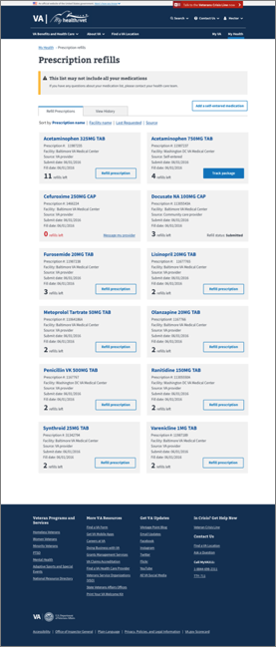
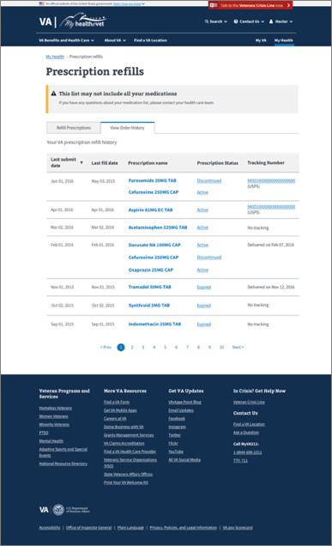
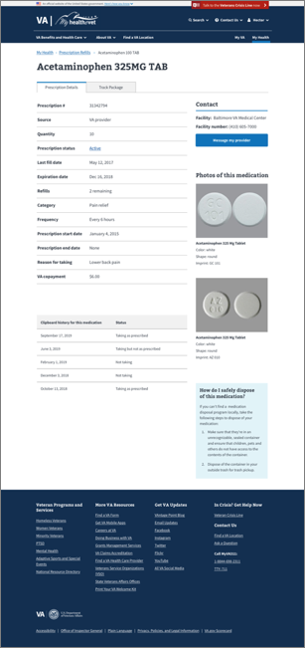
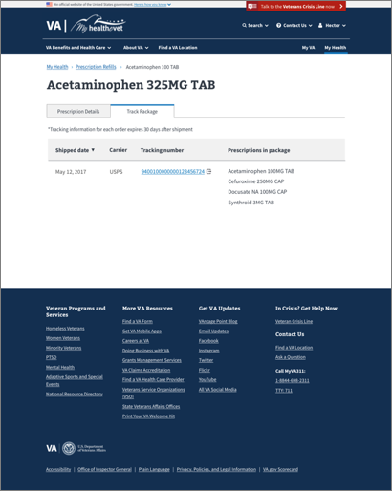
PRESCRIPTION MANAGEMENT (VA DESIGN SYSTEM)
25
Notes:
- Cerner

Slide 26
Funding and teaming approach
PRESCRIPTION MANAGEMENT
Use MHV contract and existing Bylight team to: 1. Build a new prescription service outside of existing MHV framework (to allow us to more easily retire services later). 2. Integrate the new service directly with Cerner once their APIs are ready.
3. Manage the data and serve one source of truth to vets-api.
Use an agile sprint team from HI&M (backup, CEDAR) to: 1. Build the front-end experience for prescription management and medication resolution on va.gov.
2. Connect to new prescription service.
26

Slide 27
Tool overview
Secure Messaging
Messaging initiated by provider or Veteran
Current MHV tool exists alongside and independent from VistA (for the most part)
SM will be integrated into unified Millennium on provider side
VistA/Cerner data integration necessary to deliver unified Veteran experience
Build new integration point within the MHV environment but isolated from the existing MHV application and stack

Slide 28
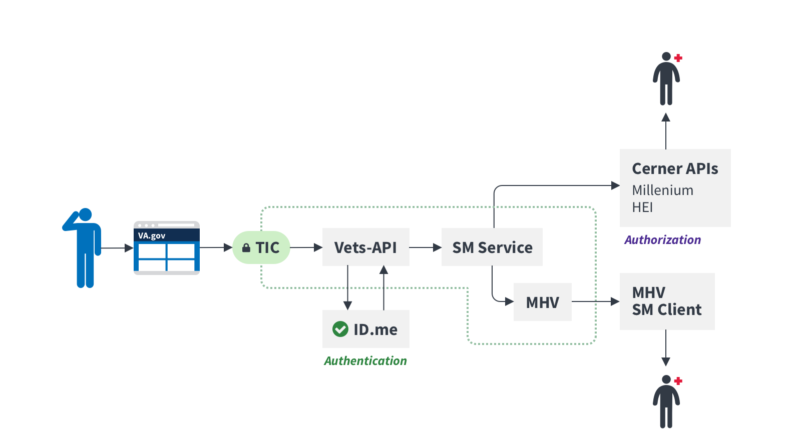
Technical approach
SECURE MESSAGING
28

Slide 29
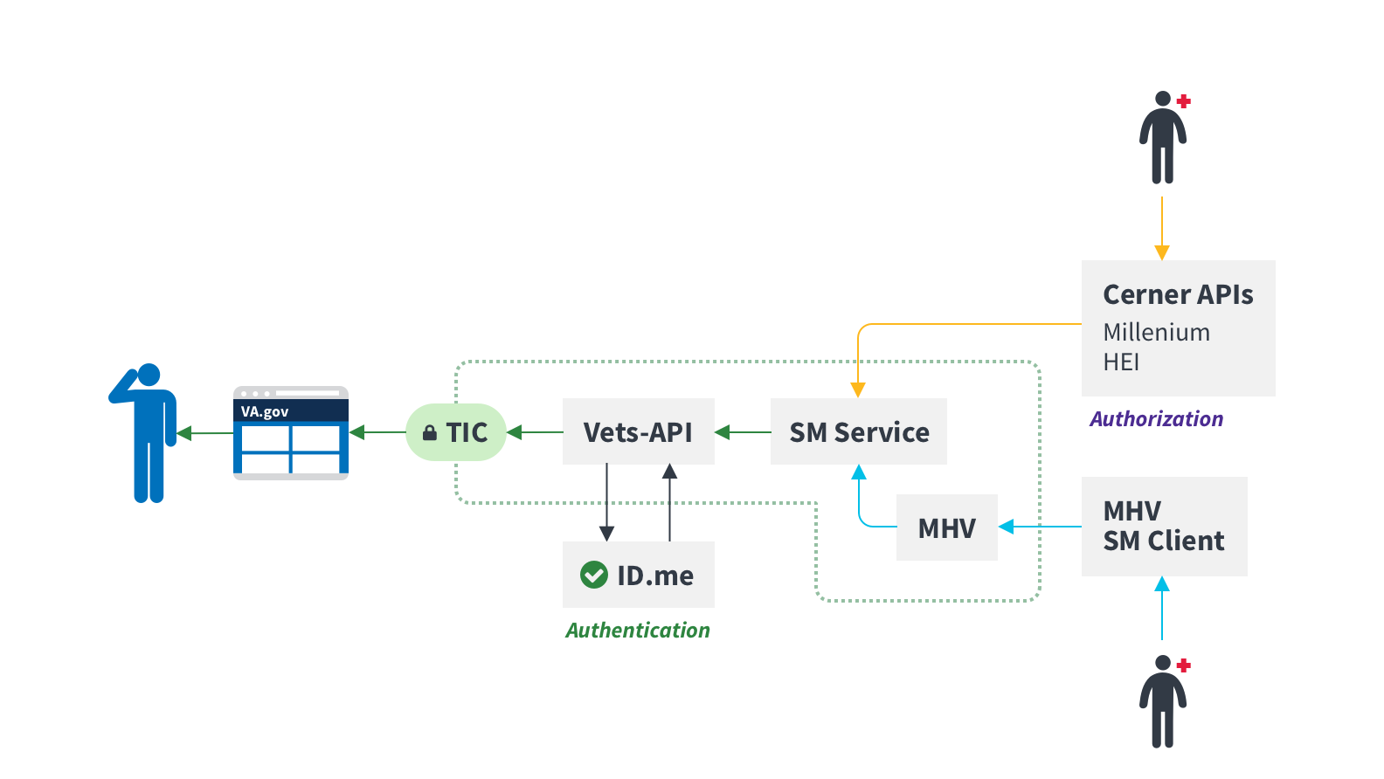
Technical approach
SECURE MESSAGING
29

Slide 30
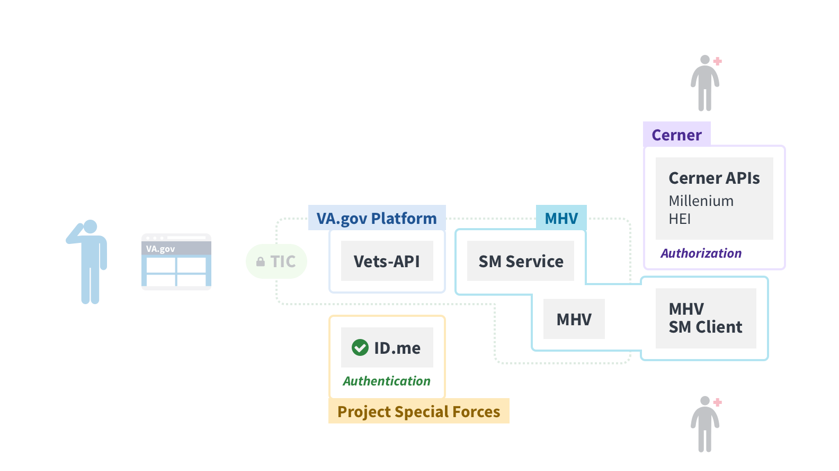
Technical approach
SECURE MESSAGING
30

Slide 31
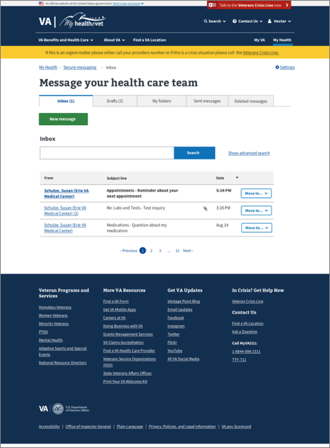
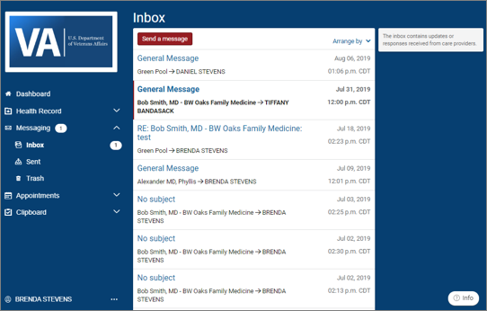
Design differences
SECURE MESSAGING
https://github.com/department-of-veterans-affairs/digitalservice/blob/master/product-lines/health/va.gov-patient-experience/va-front-door-discovery-sprint/design/ComparisonSecureMessaging.docx
31
Notes:
- Cerner

Slide 32
Funding and teaming approach
SECURE Messaging
Use MHV contract and existing Bylight team to:
Update MHV Enterprise Service APIs to fully expose existing functionality.
Build a secure message integration service outside of existing MHV stack (to allow us to more easily retire services later).
Integrate the service directly with Cerner once their APIs are ready.
Manage the data and serve one source of truth to vets-api.
32

Slide 33
Tool overview
HEALTH RECORDS/BLUE BUTTON
Veteran able to obtain all or subset of records
Possibility of leveraging Cerner write-back to CDW rather than building standalone integration point
VistA/Cerner data integration necessary to deliver unified Veteran experience
Build new integration point within the MHV environment but isolated from the existing MHV application and stack

Slide 34
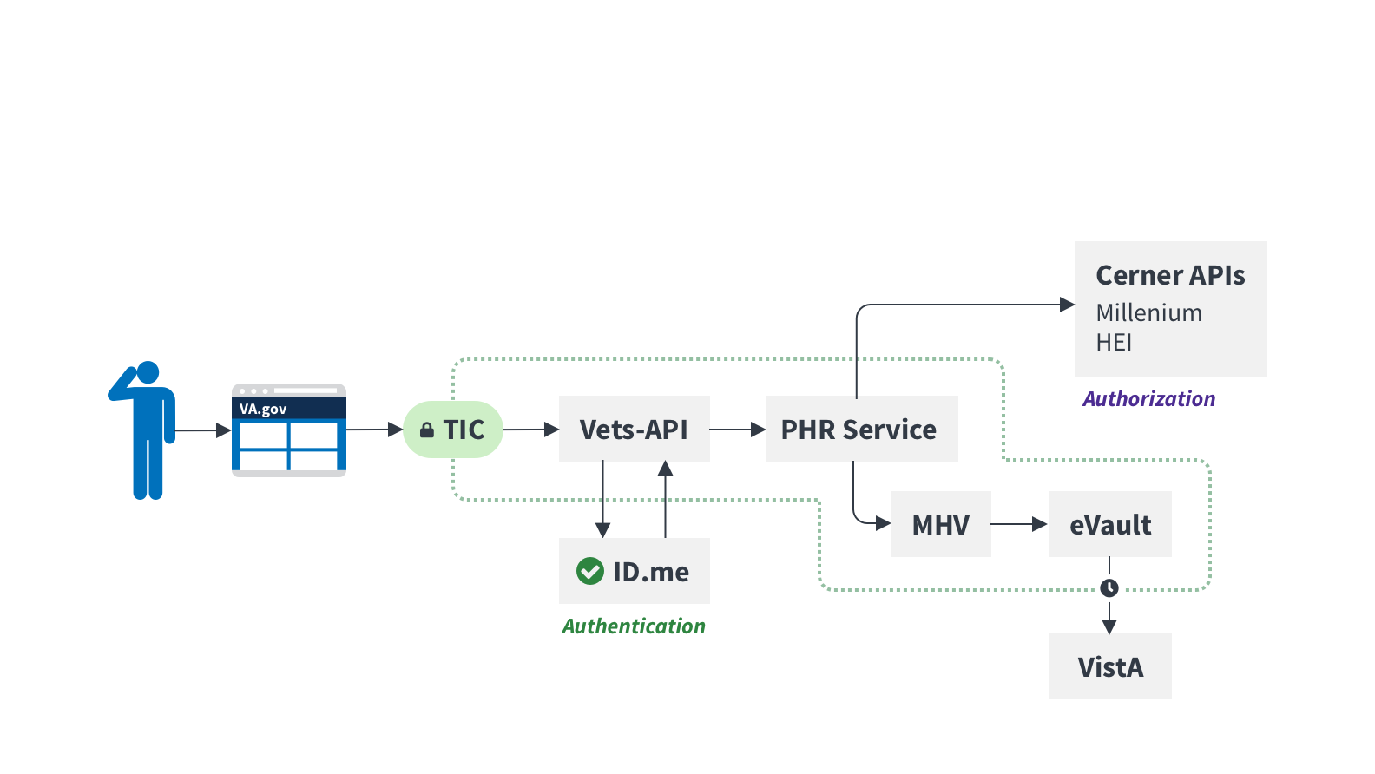
Technical approach
HEALTH RECORDS/BLUE BUTTON
34
Notes:
Should we gather confidence that EAS is reliable, standardized, and has appropriate documentation and monitoring in place, we could consider cutting vets-api out of part of this interaction to enable a more direct connection to EAS and cut out the creation of wrappers for each service.

Slide 35
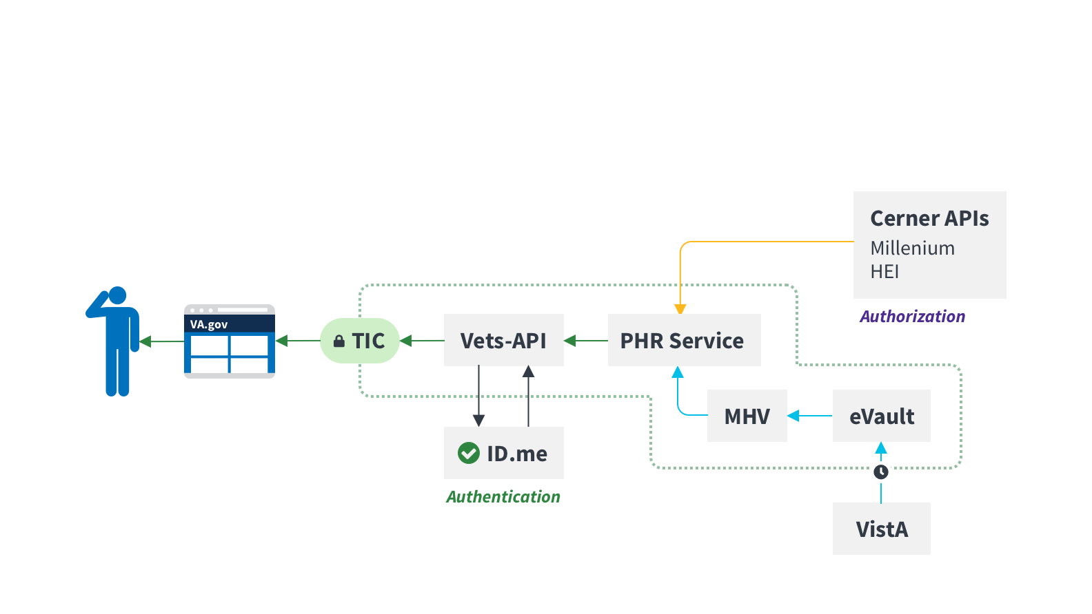
Technical approach
HEALTH RECORDS/BLUE BUTTON
35
Notes:
Should we gather confidence that EAS is reliable, standardized, and has appropriate documentation and monitoring in place, we could consider cutting vets-api out of part of this interaction to enable a more direct connection to EAS and cut out the creation of wrappers for each service.

Slide 36
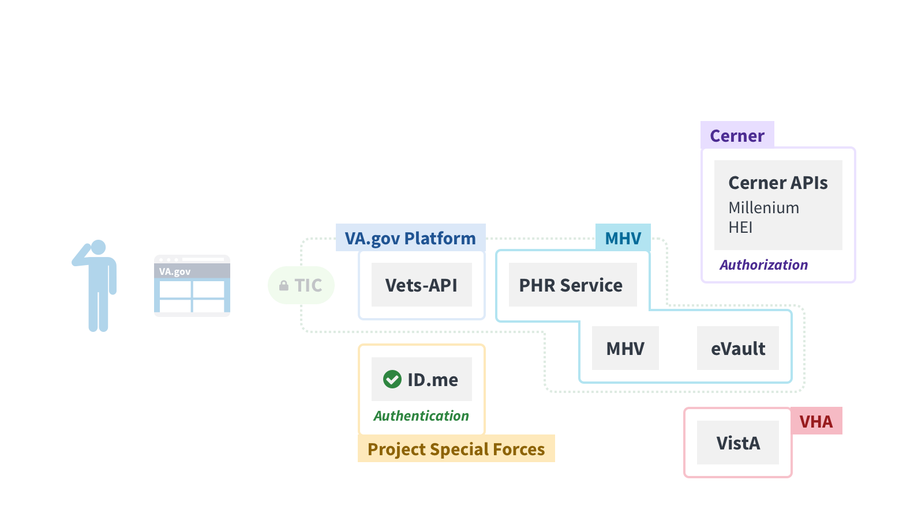
Technical approach
HEALTH RECORDS/BLUE BUTTON
36
Notes:
Should we gather confidence that EAS is reliable, standardized, and has appropriate documentation and monitoring in place, we could consider cutting vets-api out of part of this interaction to enable a more direct connection to EAS and cut out the creation of wrappers for each service.

Slide 37
Design differences
HEALTH RECORDS/BLUE BUTTON
Feature | Current MHV | Current Cerner | Vets.gov original mockups | VA.gov new mockups
Generate Blue Button medical history report | X | ? (not clear if a single full report is possible, needs further research) | X | X
Subset Blue Button data by date range | X | ? (same as above) | X | X
Subset Blue Button data by categories | X | ? (same as above) | X | X
Download patient letter |  | X (one at a time) |  | (needs further research)
Download visit summary | X | X (one at a time) | X | X
Send visit summary directly to care provider |  | X (one at a time) |  | (needs further research)
Send visit summary via insecure email |  | X (one at a time) |  | (needs further research)
Radiology report | X | X (one at a time) | X | X
Pathology report | X | X (one at a time) | X | X
Clinical note | X | X (one at a time) | X | X
Microbiology report | X | X (one at a time) | X | X
Medications | X |  | X | X
EKG history | X |  | X | X
Allergies | X |  | X | X
Immunizations | X |  | X | X
Vitals and readings | X |  | X | X
Self-reported health history | X |  | X | X
Food and activity journals | X |  | X | X
Goals | X |  | X | X
Demographics and health insurance | X |  | X | X
Military service information | X |  | X | X
37
Notes:
- Cerner

Slide 38
Design differences
HEALTH RECORDS/BLUE BUTTON
Feature | Current MHV | Current Cerner | Vets.gov original mockups | VA.gov new mockups
Download Blue Button report as PDF | X | ? (same as above) | X | X
Download Blue Button report as TXT | X | ? (same as above) | X | X
View Blue Button report online | X | ? (same as above) |  | (needs further research)
View VA Health Summary online | X | ? (same as above) |  | X
Download VA Health Summary as PDF | X | ? (same as above) |  | X
Download VA Health Summary as XML | X | ? (same as above) |  | X
Send VA Health Summary to a non-VA care provider via Direct Message | X |  |  | (needs further research)
View medical images and reports online | X |  |  | (needs further research)
Download medical images and reports as PDF | X | X (one at a time) |  | (needs further research)
Download medical images and reports as TXT | X | X (one at a time) |  | (needs further research)
All download requests saved in account activity history | X |  |  | (needs further research)
https://github.com/department-of-veterans-affairs/digitalservice/blob/master/product-lines/health/va.gov-patient-experience/va-front-door-discovery-sprint/design/ComparisonBlueButton.docx
38
Notes:
- Cerner

Slide 39
Design differences
HEALTH HISTORY
Feature | Current MHV | Current Cerner | Vets.gov original mockups | VA.gov new mockups
Allergies from VA | X | X (from provider) | n/a | X (can we combine into one table? Needs further research)
Allergies (self-entered) | X | X | n/a | X (can we combine into one table? Needs further research)
Immunizations | X | X | n/a | X (can we combine into one table? Needs further research)
Immunizations (self-entered) | X | X | n/a | X (can we combine into one table? Needs further research)
Medical events (self-entered) | X | X | n/a | X (can we combine into one table? Needs further research)
Personal summary (link to Blue Button) | X |  | n/a | (can we get rid of this and just link to BB?)
Family health history | X | X | n/a | X (can we combine into one table? Needs further research)
Military health history | X |  | n/a | X (can we combine into one table? Needs further research)
Social history |  | X |  | Same as journals from MHV?
https://github.com/department-of-veterans-affairs/digitalservice/blob/master/product-lines/health/va.gov-patient-experience/va-front-door-discovery-sprint/design/ComparisonHealthHistory.docx
39
Notes:
- Cerner

Slide 40
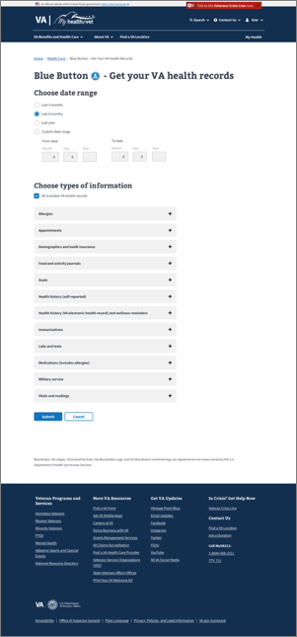
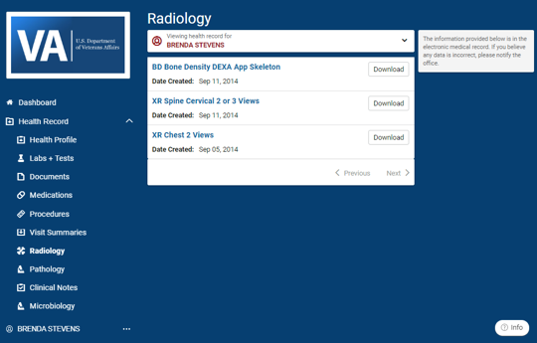
Design differences
HEALTH RECORDS/BLUE BUTTON

Slide 41
Funding and teaming approach
HEALTH RECORDS/BLUE BUTTON
Use MHV contract and existing Bylight team to:
Update MHV Enterprise Service APIs to fully expose existing functionality.
Build a secure message integration service outside of existing MHV stack (to allow us to more easily retire services later).
Integrate the service directly with Cerner once their APIs are ready.
Manage the data and serve one source of truth to vets-api.
41

Slide 42
Authentication and authorization
Recommendations
Authentication for all tools handled through existing ID.me flow on VA.gov (including other identity providers like DSLogon)
Leverage enterprise SSOe program where possible
Authorization for VistA and other legacy backends likely handled at MHV or EAS layer
Develop strategy to leverage Cerner authorization framework rather than rely on system-level tokens

Slide 43
Funding and teaming support
All products/Overall Support
We envision a close relationship with MHV and recognize & appreciate the value that MHV provides in bridging in-person and digital health services. In addition to developing new services and handling interactions, MHV provides:
Coordinators, in-person support
Help center
Communication (newsletter, blogs, outreach)
Administration/leadership/coordination with VHA partners
43

Slide 44
Status and next steps
Fiscal review
Task order language and execution for Cerner APIs
IJP and budget allocation for patient experience
Prioritization, roadmapping, and transition planning
Contracting / task order patient experience
Identification of DEPO/OCC/OIT team
Team to take on VAOS post-June

